Slide 1
Asymmetric copula in multivariate flood frequency analysis
Hannes Grün, Robin Schüttpelz

Slide 2
Relevance
Floods: Among most severe natural hazards worldwide
Multivariate flood analysis: Interdependence of flood event characteristics
Asymmetric copula functions: Varying strength of dependence between variables, allowing flexible modelling.

Slide 3
Dependence Structure
Relevant Variables: Flood peak (P), Duration (D), Volume (V).
Influences on Dependencies: P affects dependence structure between D & V
Relevant Influences: Portray multivariate dependencies in accurate manner

Slide 4
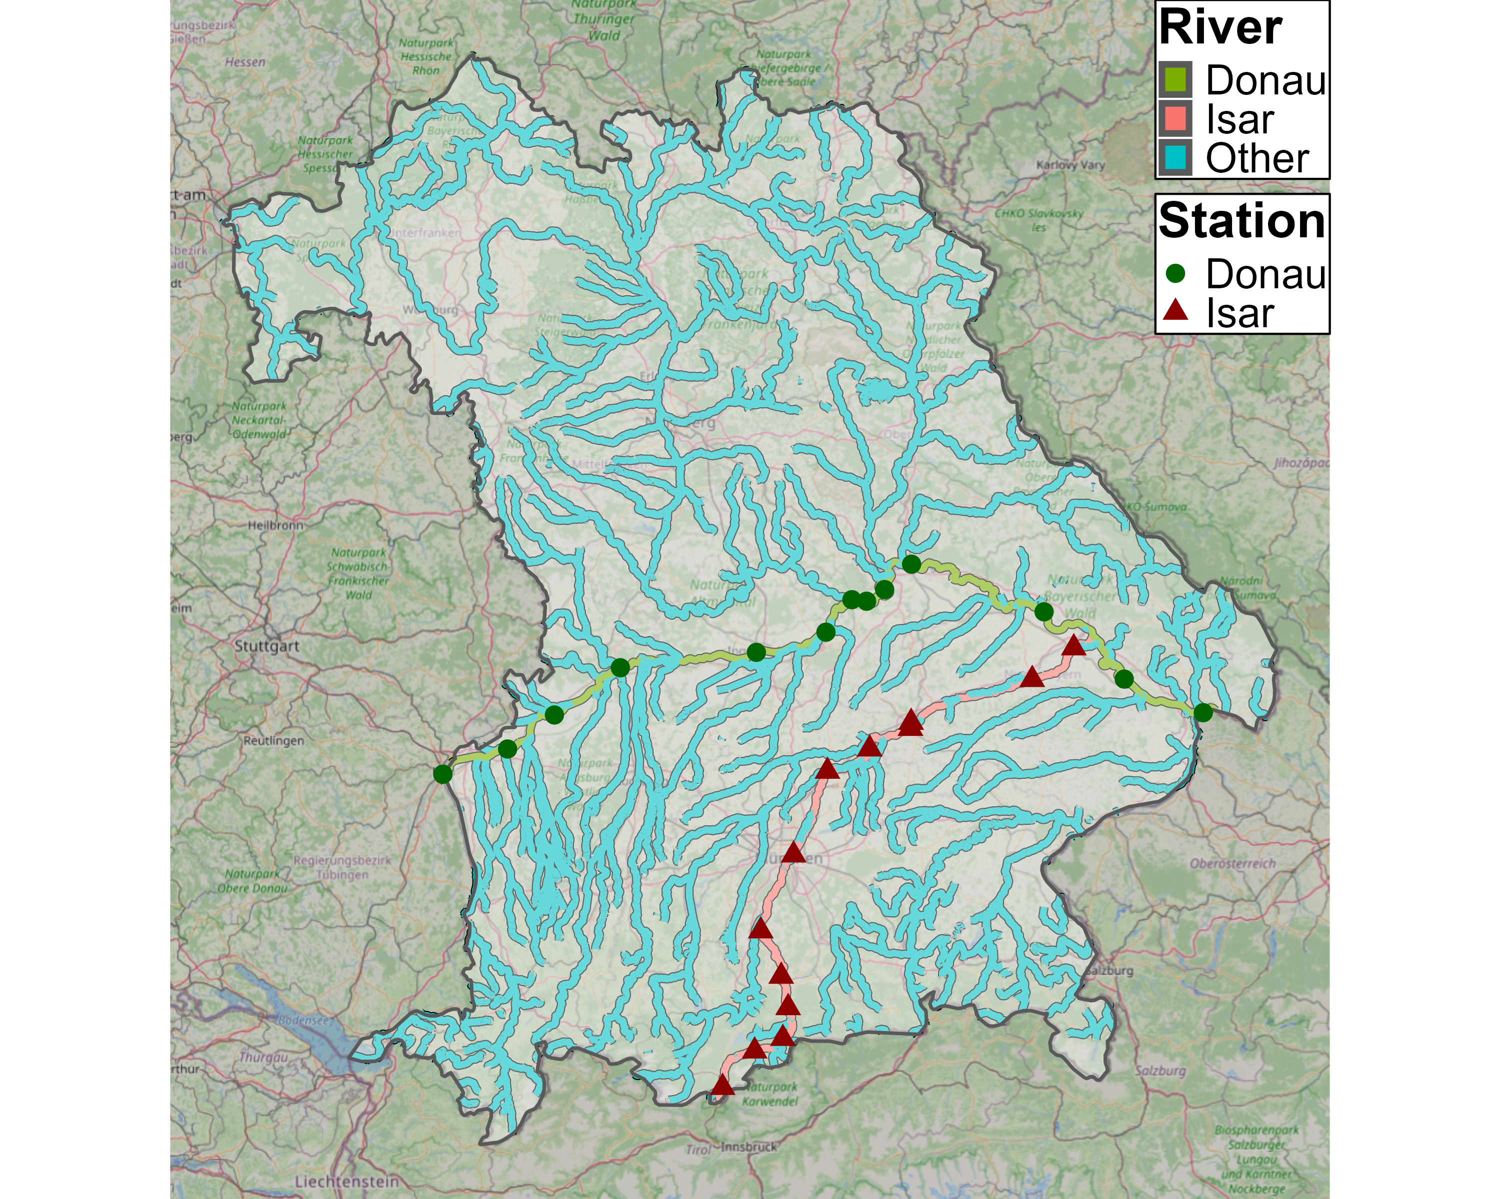
Data - Selection

Slide 5
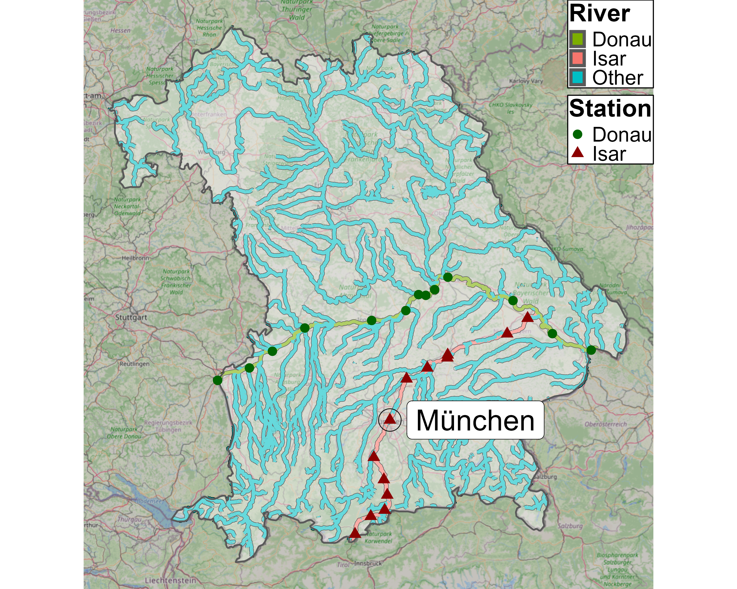
Data - Selection

Slide 6
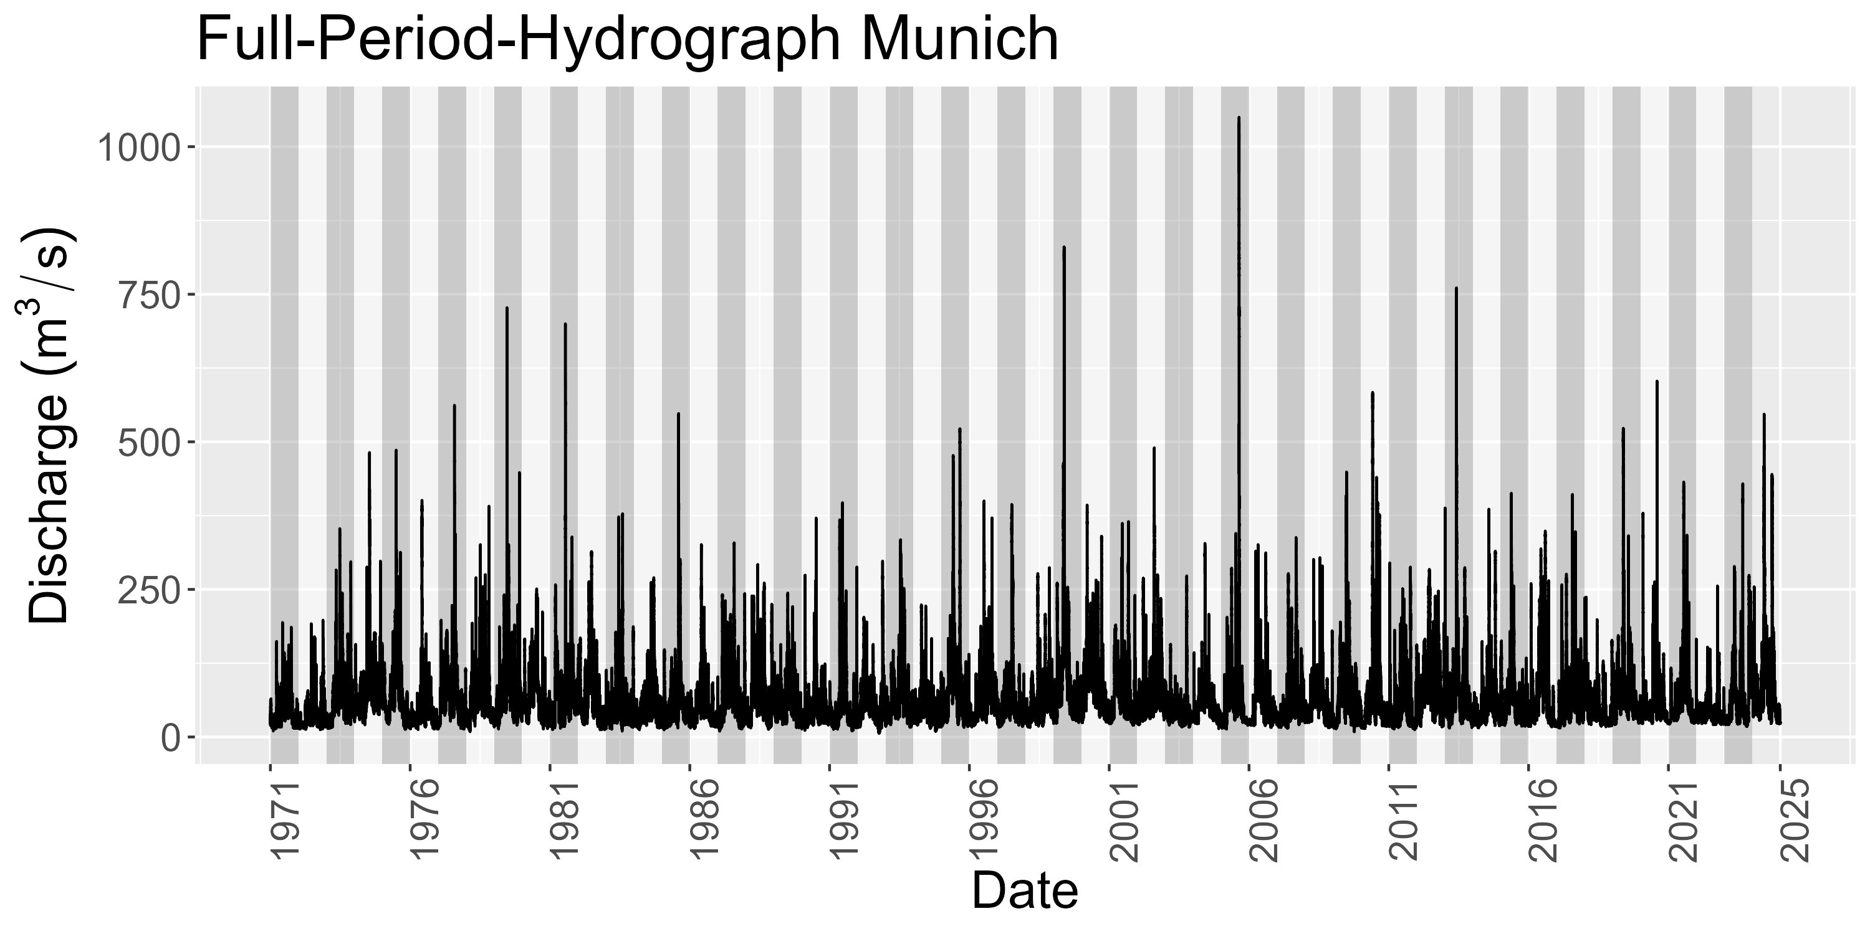
Data – Munich Station
Notes:
Hydrograph over 54 years
See later: number of years are number of observations per station

Slide 7
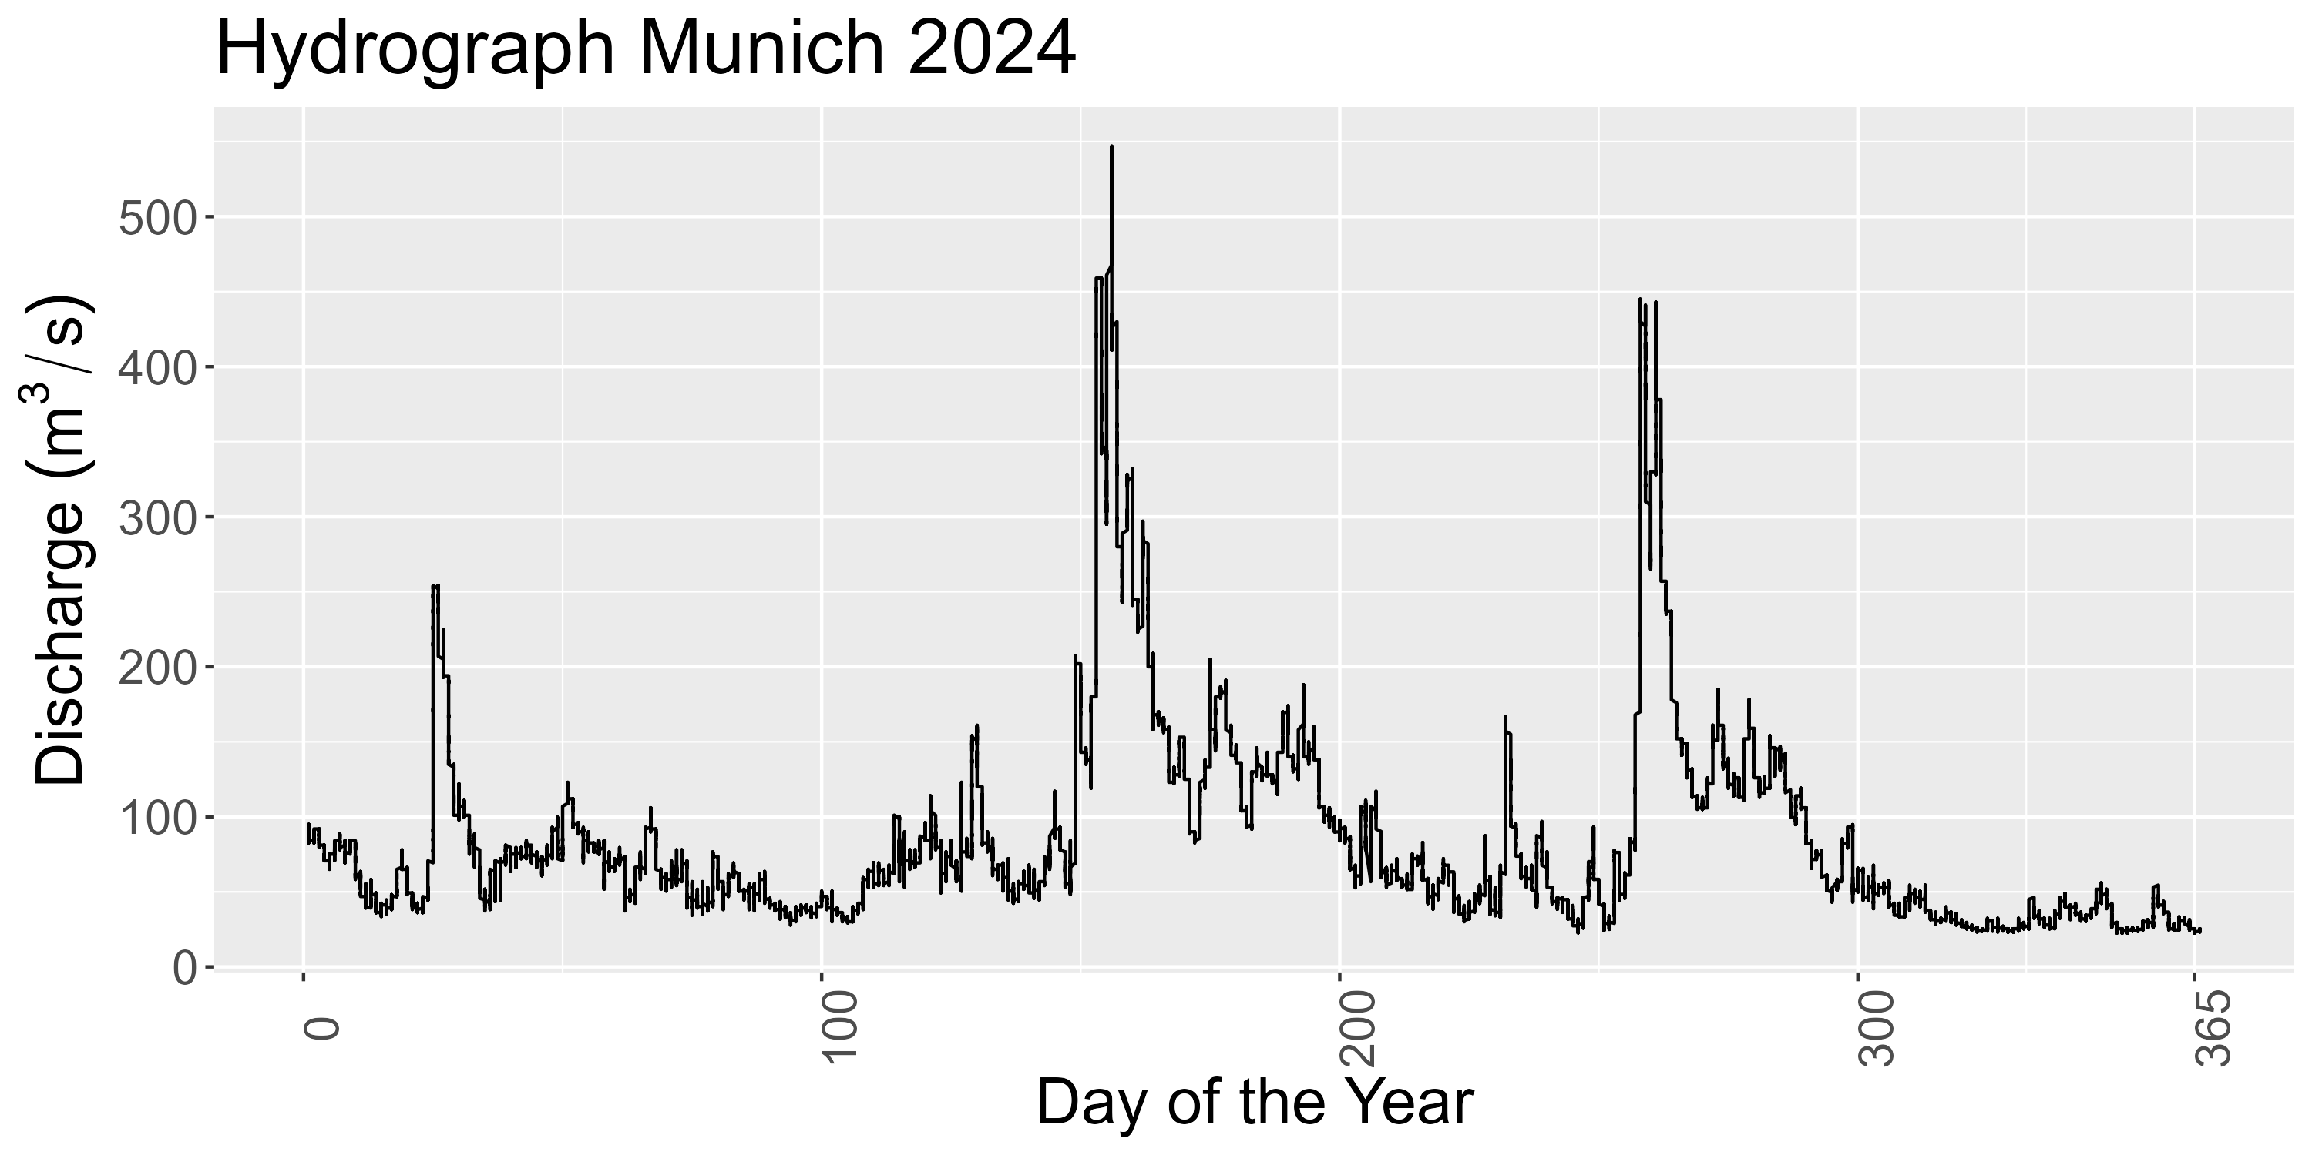
Data – Munich Station

Slide 8
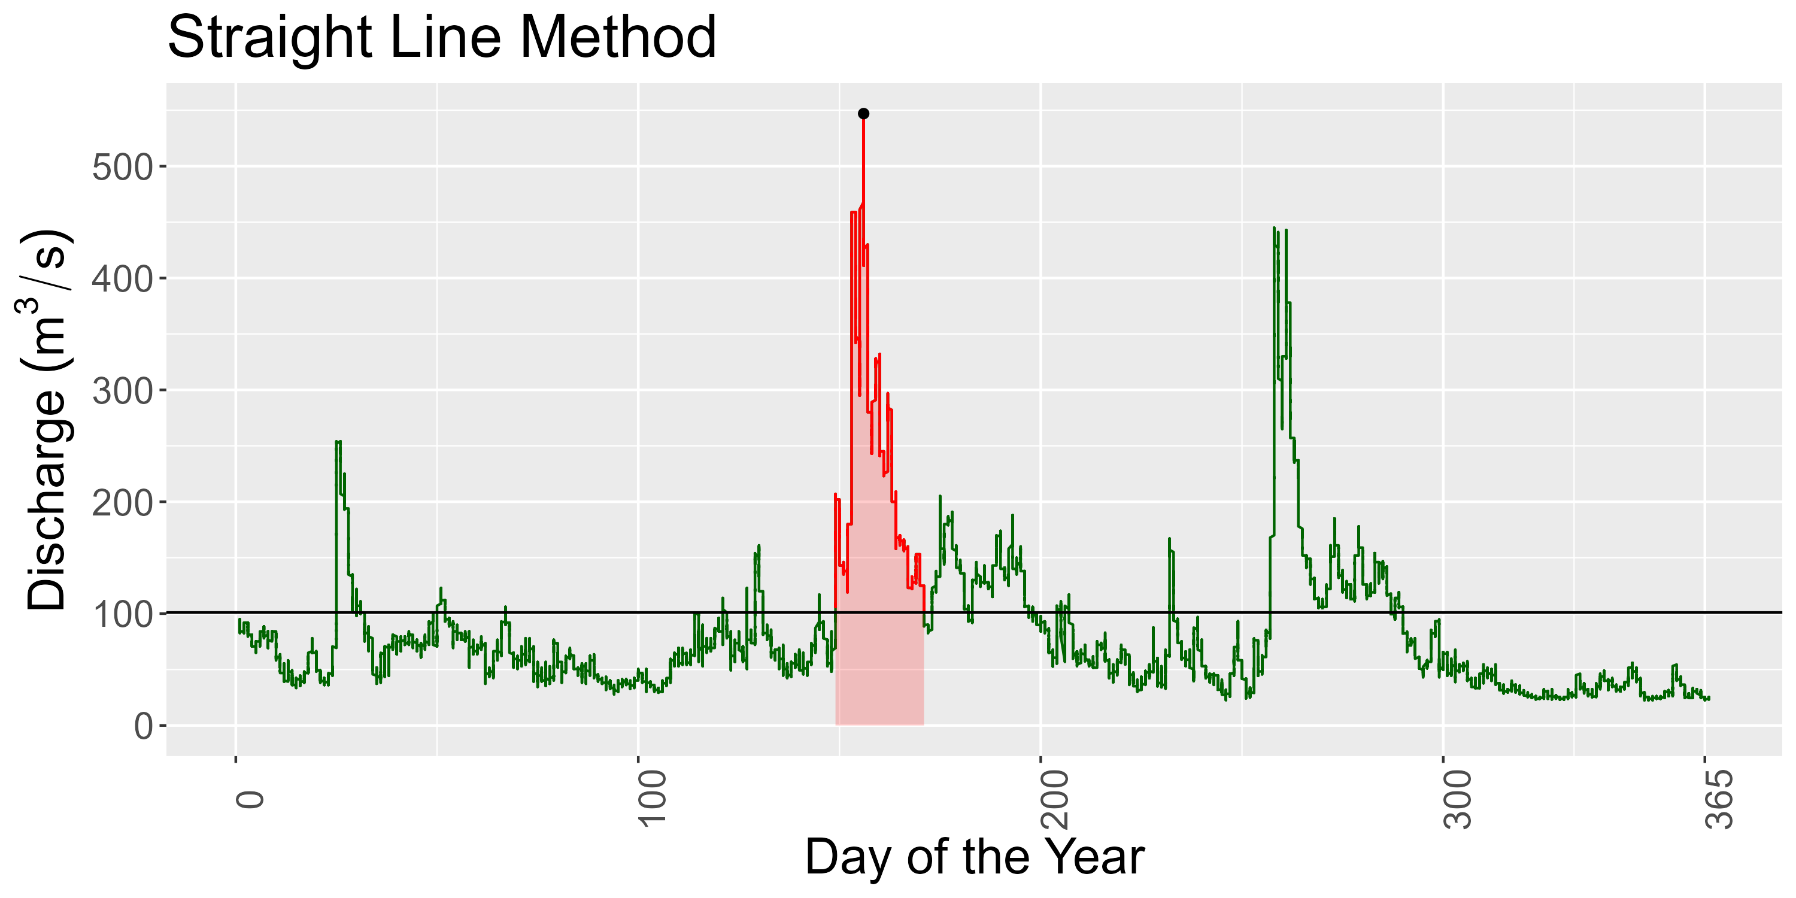
Data – Munich Station
Notes:
Contrary to the paper, we do not use fixed threshold
Reason: Fixed threshold is not reasonable IMO bc we are intersted in the dependence strucutre
Dependence structure / correlation is scale independent

Slide 9
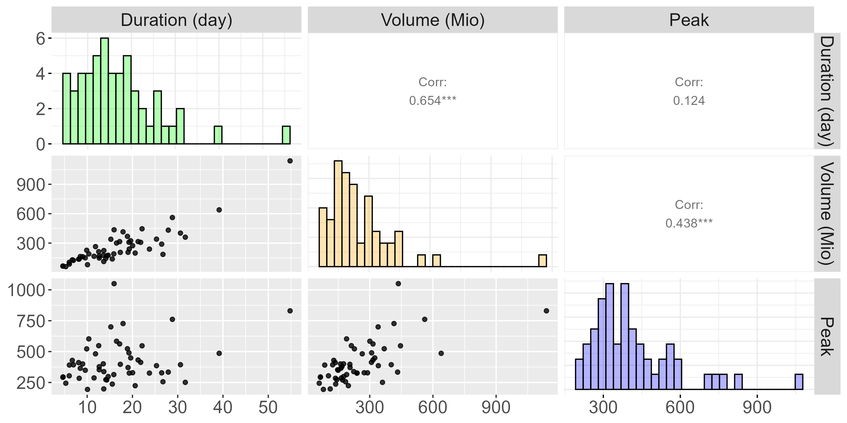
Data – Munich Station
Notes:
Do that for every year to obtain nobs = #years observations
This data used to fit station specific copula

Slide 10
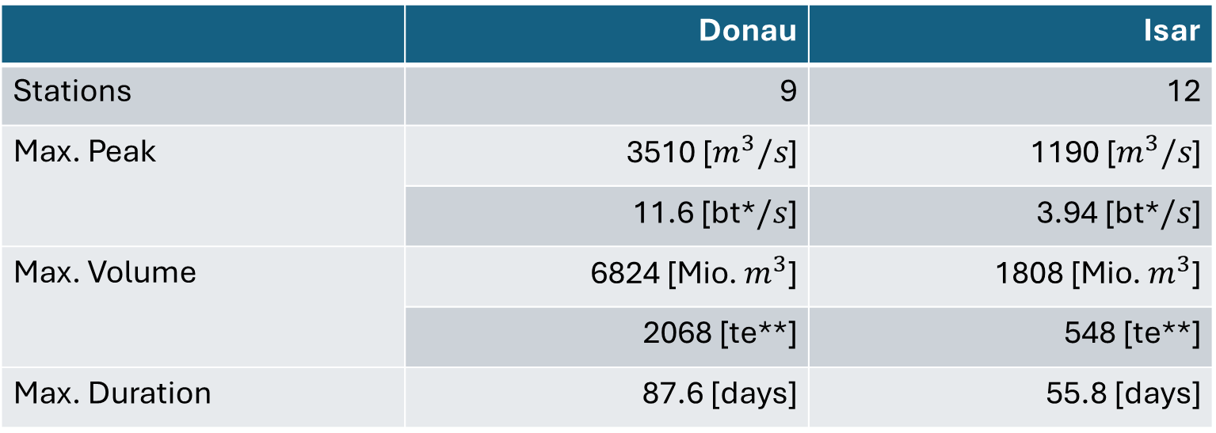
Data – Summary
 | Donau | Isar
Stations | 9 | 12
Max. Peak | 3510 [$m^{3}/s$] | 1190 [$m^{3}/s$]
 | 11.6 [bt*$/s$] | 3.94 [bt*$/s$]
Max. Volume | 6824 [Mio. $m^{3}$] | 1808 [Mio. $m^{3}$]
 | 2068 [te**] | 548 [te**]
Max. Duration | 87.6 [days] | 55.8 [days]
*bt denotes unit „bathtub“
**te denotes unit „Therme Erdingen“
Notes:
2 Rivers, 27 stations where: 6 have below 30 observations -> remove those bc pretty little infor for following methods
After removing: 2 Rivers, 21 stations: Donau: 9, Isar 12
Majority of stations have sample size of 54 with only 2 stations nobs between 44 and 50
In total, we have data on 1122 flood events
Largest observations by river:
Max peak in Donau: 3510 -> that is 11 Bathtubs/s
Max peak in Isar: ~4 bathtubs/s
Max vol in Donau: 6824 -> That is 2068 x Therme Erdingen (Flood took 46 days; in year 1988)
Max vol in Isar: 548 x Therme Erdingen (Flood took 48 days; in year 1999)
Max Duration Donau: 87 days
Max Duration in Isar: 56 days
Duration Reminder: A river is flooded as long as its discharge is above ist 75% quantile;
i.e. It took 87 bzw. 56 days for the discharge to drop below the 75% quantile within that year

Slide 11
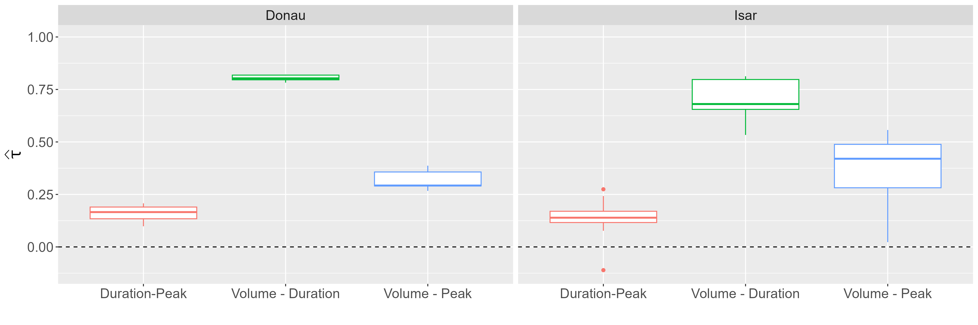
Data – Correlation
Notes:
Boxplots:
Distribution for all Kendall Correlation Coefficients
Tau higher variation in Isar, one correlation even below 0 (Mittenwald)
Important to note: There seem to be three distinct correlation values / three distrinct strength of dependence (Like already seen for Munich station)
Volume-Duration largest by far, then Volume-Peak, then Duration-Peak. This holds for both rivers
That is, the behavior we saw for the Munich station does also hold for the other stations
This is VERY important because it implies the violation of NACs
Here critizing the paper:
The paper applies NACs without every showing scatterplots or the correlation among the variables. When comparing our analysis to their, we missed those
Thus, we are uncertain if NACs were applicable to the data in the paper?
In our simulation study we will see what happens if NAC applied to vine DGP
>> This brings us to methods part ☺

Slide 12






Methods - NACs
$$C\left(u_{1},u_{2},u_{3}\right)=C_{1}\left({u_{1},C}_{2}\left(u_{2},u_{3}\right)\right)$$
$$C_{1}$$
$$u_{1}$$
$$C_{2}$$
$$u_{2}$$
$$u_{3}$$
Notes:
Unusual about presentation: We do not introduce Sklar
That is, keep it digestable for everyone
Low math
BUT
Last time: Only this C equation
From before:
Will not introduce a lot of theory
Keep it intro level friendly
Thus:
Applied NAC example
Basic theory:
Copula is a joint cdf with uniform margins (more on that later. For now think of it as just a function)
Allows to decouple marginal distribution and dependence strucutre
NAC special AC that allow partial asymmetry FORMULA
CDF:
- Function that gives probability X<= x

Slide 13

Methods - NACs
$$C\left(u_{1},u_{2},u_{3}∥θ_{1},θ_{2}\right)=ϕ_{1}^{−1}\left(ϕ_{1}\left(u_{1}∥θ_{1}\right)+ϕ_{1}∘ϕ_{2}^{−1}\left(ϕ_{2}\left(u_{2}∥θ_{2}\right)+ϕ_{2}\left(u_{3}∥θ_{2}\right)\right)∥θ_{1}\right)$$
Notes:
Now: Bit more details on generator functions
> What does it mean to fit a copula
> Different copula families are defined by this function

Slide 14
Methods - NACs
$$C\left(u_{1},u_{2},u_{3}∥θ_{1},θ_{2}\right)=ϕ_{1}^{−1}\left(ϕ_{1}\left(u_{1}∥θ_{1}\right)+ϕ_{1}∘ϕ_{2}^{−1}\left(ϕ_{2}\left(u_{2}∥θ_{2}\right)+ϕ_{2}\left(u_{3}∥θ_{2}\right)\right)∥θ_{1}\right)$$
$$C_{1}$$
$$u_{1}$$
$$C_{2}$$
$$u_{2}$$
$$u_{3}$$
Notes:
First: Link this generator structure to graph
Connect these to graph
Mention resulting limitation !!
> Imagine copulas not as function, but just as something encoding the dependence structure
> For NACs, we only estimate 2 copulas -> Only 2 unique dependence structures!
Thus: NACs assume the same dependence structure between 2 pairs of variable

Slide 15
Methods - NACs
$$C\left(u_{1},u_{2},u_{3}∥θ_{1},θ_{2}\right)=ϕ_{1}^{−1}\left(ϕ_{1}\left(u_{1}∥θ_{1}\right)+ϕ_{1}∘ϕ_{2}^{−1}\left(ϕ_{2}\left(u_{2}∥θ_{2}\right)+ϕ_{2}\left(u_{3}∥θ_{2}\right)\right)∥θ_{1}\right)$$
$$C_{1}$$
$$u_{1}$$
$$C_{2}$$
$$u_{2}$$
$$u_{3}$$
Notes:
Connect these to graph
Mention resulting limitation !!
> Imagine copulas not as function, but just as something encoding the dependence structure
> For NACs, we only estimate 2 copulas -> Only 2 unique dependence structures!
Thus: NACs assume the same dependence structure between 2 pairs of variable

Slide 16
Methods - NACs
$$C\left(u_{1},u_{2},u_{3}∥θ_{1},θ_{2}\right)=ϕ_{1}^{−1}\left(ϕ_{1}\left(u_{1}∥θ_{1}\right)+ϕ_{1}∘ϕ_{2}^{−1}\left(ϕ_{2}\left(u_{2}∥θ_{2}\right)+ϕ_{2}\left(u_{3}∥θ_{2}\right)\right)∥θ_{1}\right)$$
$$C_{1}$$
$$u_{1}$$
$$C_{2}$$
$$u_{2}$$
$$u_{3}$$
Notes:
Connect these to graph
Mention resulting limitation !!
> Imagine copulas not as function, but just as something encoding the dependence structure
> For NACs, we only estimate 2 copulas -> Only 2 unique dependence structures!
Thus: NACs assume the same dependence structure between 2 pairs of variable

Slide 17
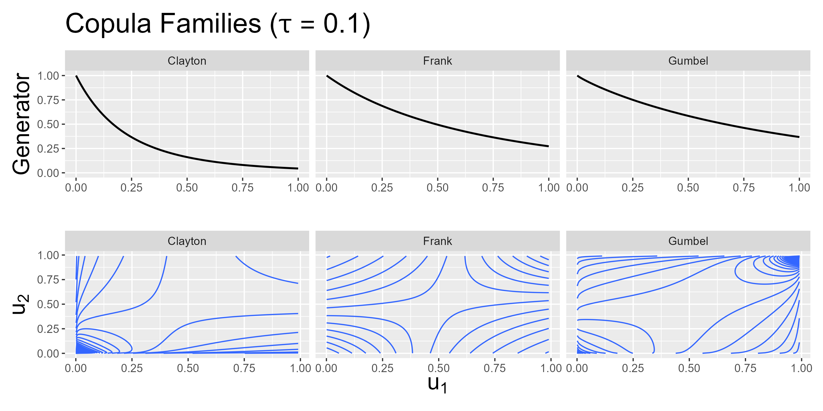
Methods - Generators
Notes:
Learning now that generators exist, we can further talk about copula families
Gumbel, Clayton, Frank
Each family defined by is generators
Generator depends on one paramter bzw. on tau
> Estimating this parameter / tau and asuming a copula family gives full BIVARIATE dependence structure
> Plot each and discuss properties / tail dependence
!! Add 1-u and survival copula into appendix!
! Explicitly mention the x –axes in both plots

Slide 18
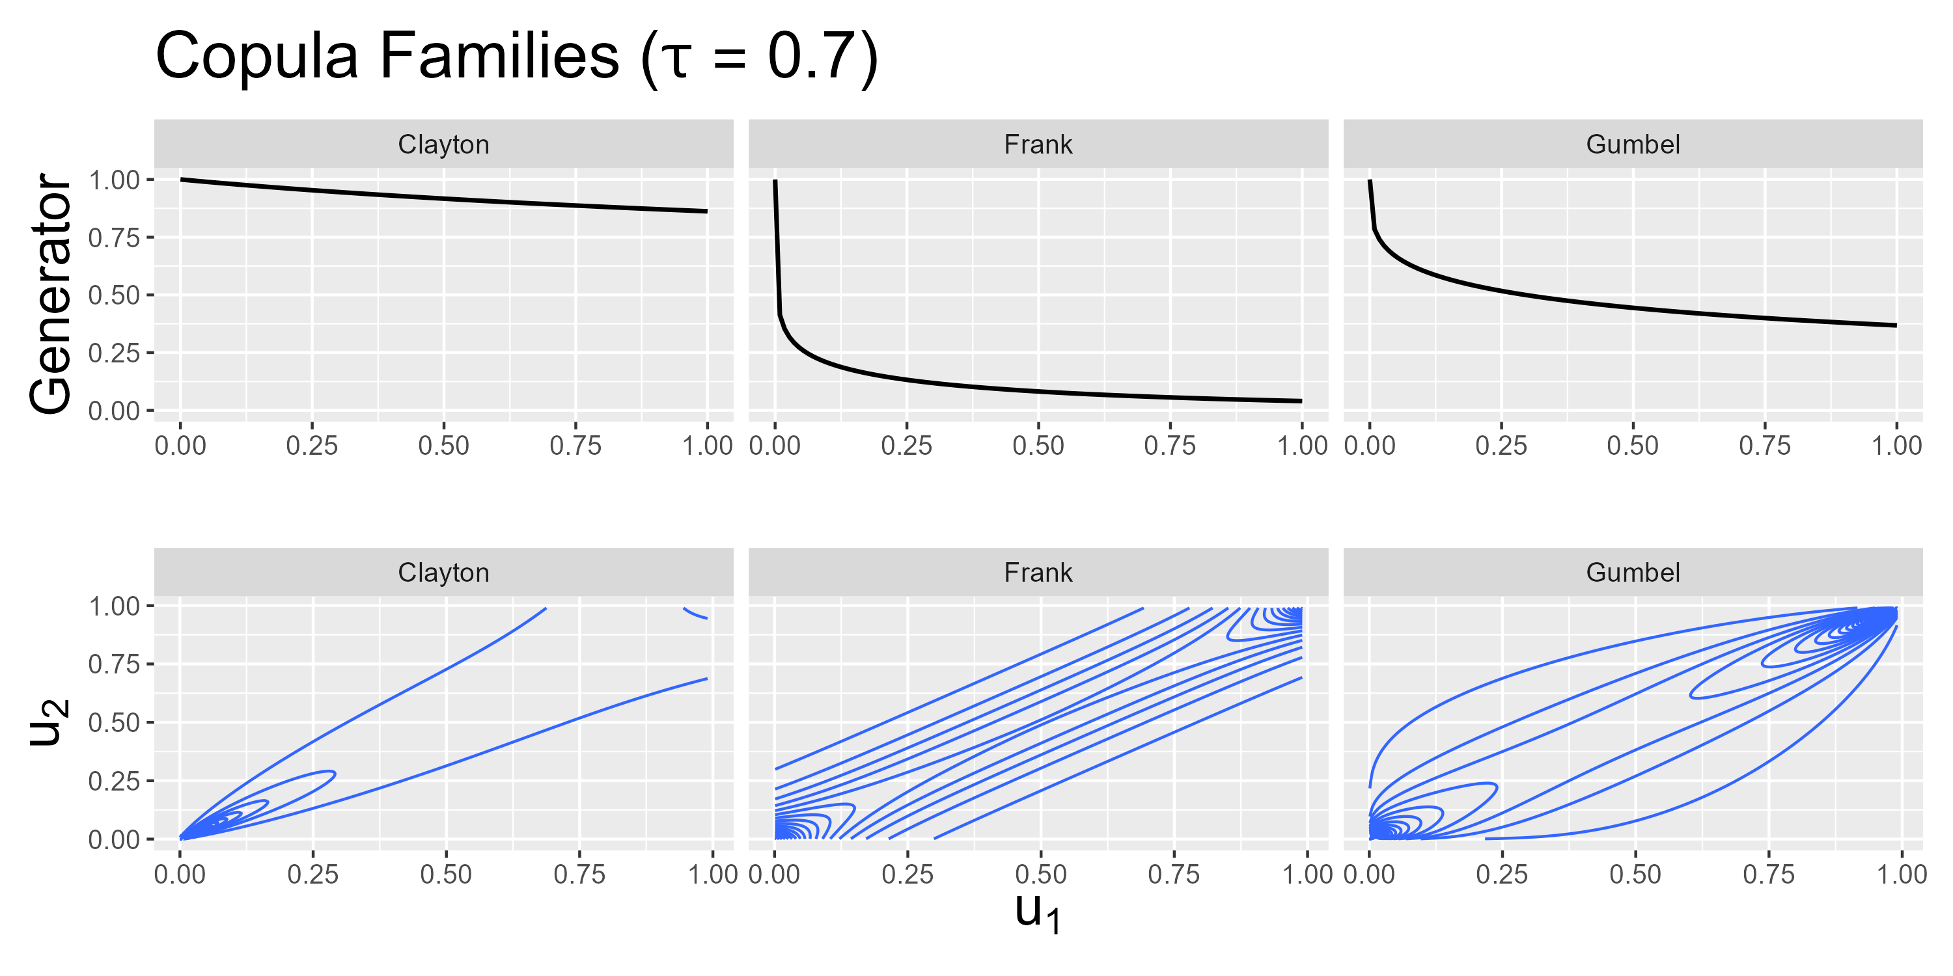
Methods - Generators
Notes:
Learning now that generators exist, we can further talk about copula families
Gumbel, Clayton, Frank
Tail Dependence:

Slide 19
Methods – (Simplified) Vines

Slide 20
Simulation – Setup
Parameter | Value
Sample size | 15, 30, 50, 1000
Correlation | Donau, Isar, LowHighHigh, LowMedHigh
Iterations per setup | 3000 (NACs) -> 1k each cop fam 27000 (Vines) -> 1k each combination of fams (3^3)
Copula Families | Gumbel, Clayton, Frank
Notes:
Reason to draw family type etc randomly: Saves a bunch of for-loops when implementing and due to large number of iterations, fraction will tend towards selection probability. i.e. Equally selection of combinations
> GOOD QUESTION TO BE ASKED

Slide 21
Simulation – NAC DGP
Notes:
Mainly about confirming paper simulation finding AC vs NACs, but also check Vine performance if NAC true
KLD by sample size over all correlation types and copula families
KLD and Paper confirmation

Slide 22
Simulation – Vine DGP
Notes:
KLD

Slide 23
Simulation – Vine DGP
Notes:
- Overestimation NAC

Slide 24
Simulation – Vine DGP
Notes:
- AIC discussion

Slide 25
Results

Slide 26
Summary
TODO: Show this as last slide and display Key findings.
So ppl can refer see everything and can refer to it

Slide 27
Appendix

Slide 28
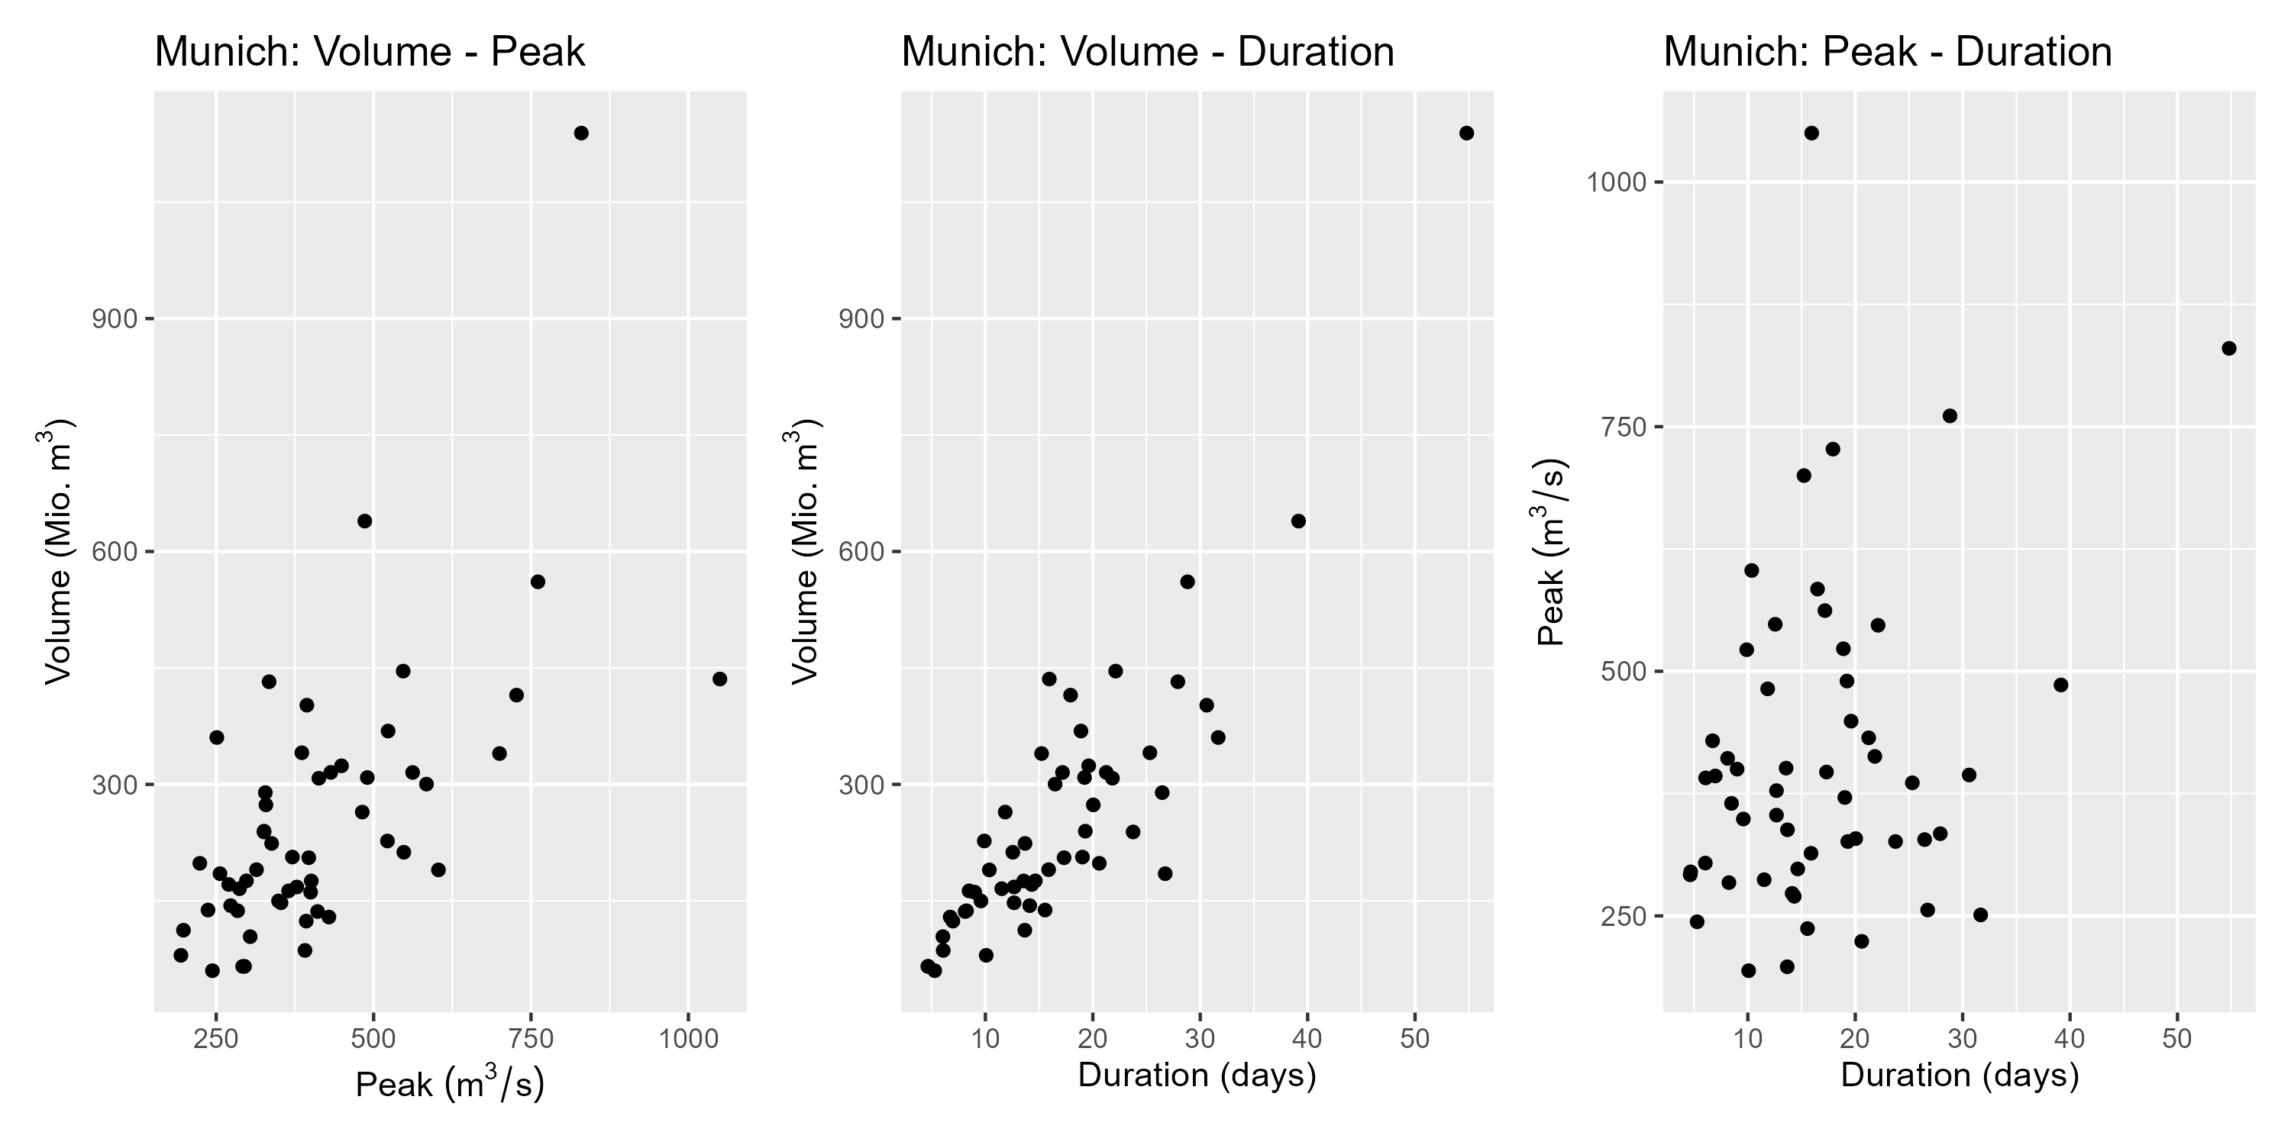
Appendix

Slide 29
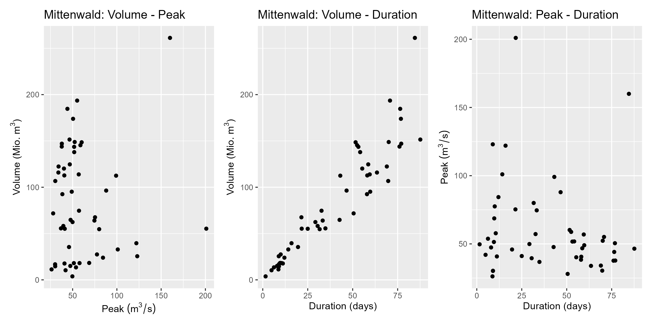
Appendix
Notes:
Negative correlation for duration-peak

